Slide 1
XX. Sitzung der/des
DZHK Gremium xy
xx. Monat 20xx, 12:00-15:00 Uhr
Videokonferenz

Slide 2
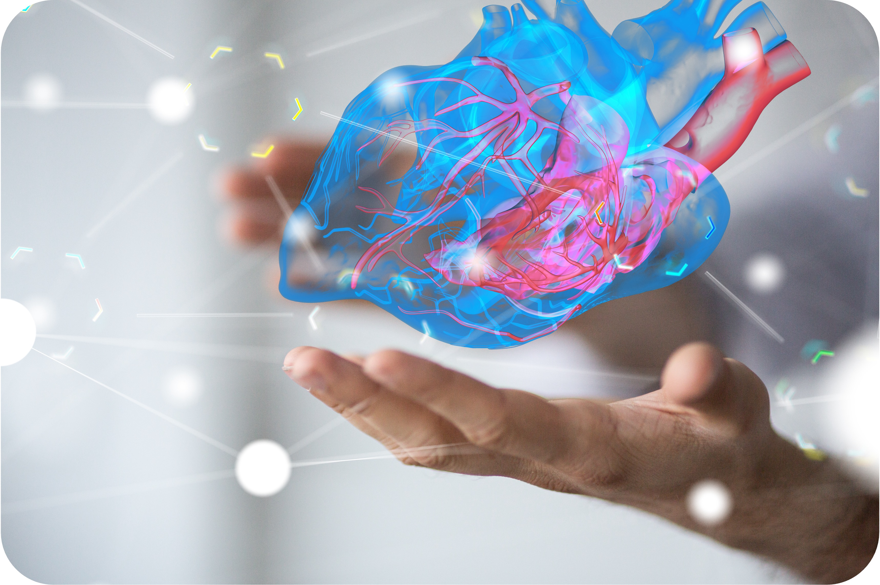
XX. Sitzung der/des
DZHK Gremium xy
xx. Monat 20xx, 12:00-15:00 Uhr
Alternatives Coverchartdesign

Slide 4




Innovation Clusters – an integrated approach
NEW: starting in 2024
INNOVATION CLUSTERS:
Key topics in cardio-vascular research
All partner sites participating
National and international relevance
XYZ therapy
(started 2018)
Nucleic acid therapies
(extension)
XYZ
Therapy
(2018-2024)
Heart brain interfaces

Slide 5
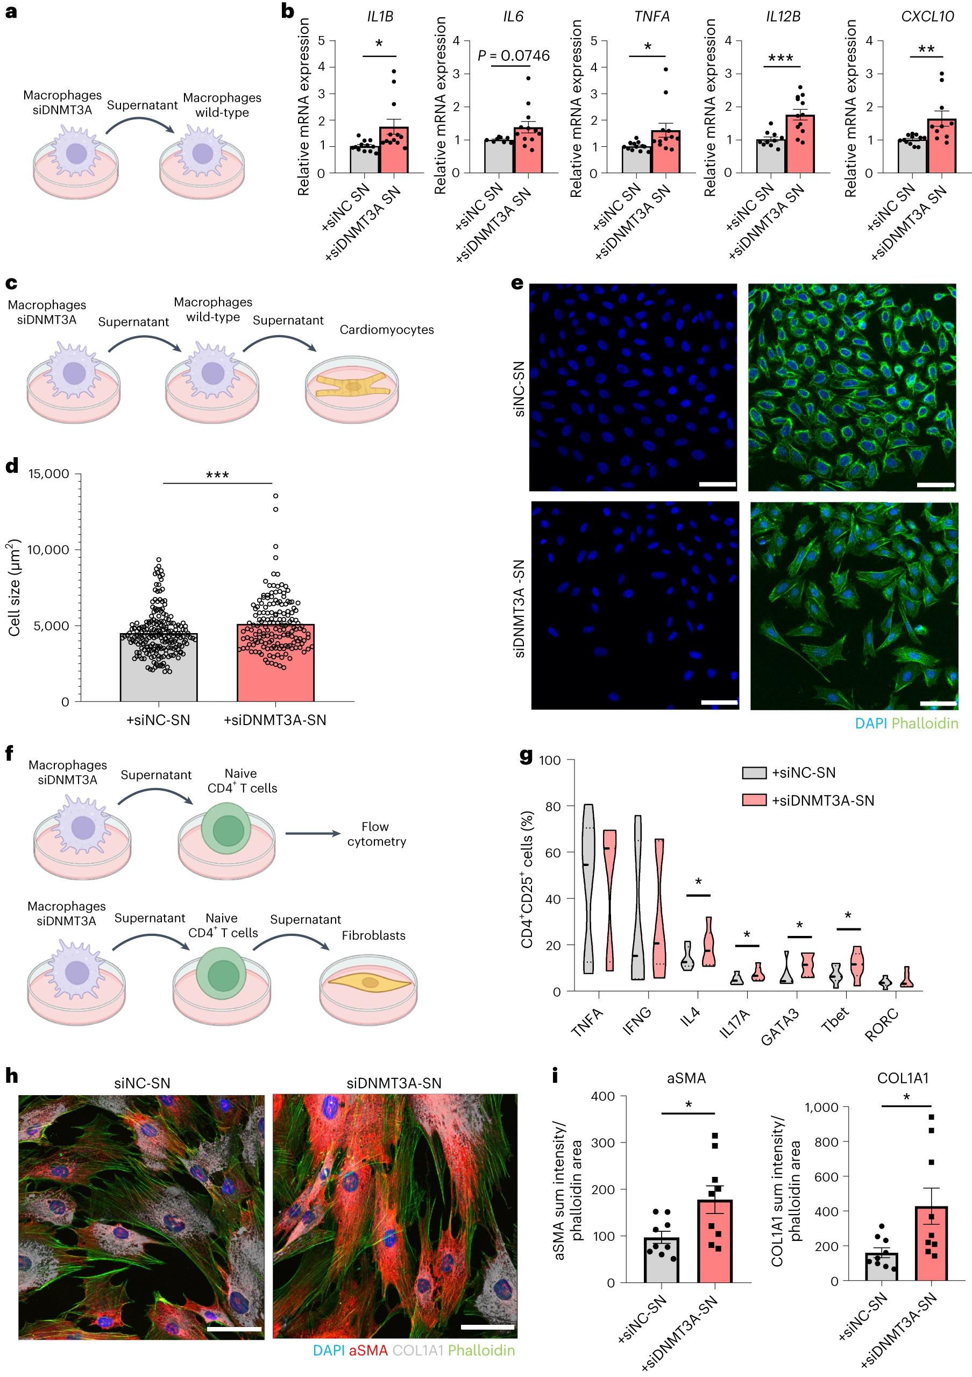
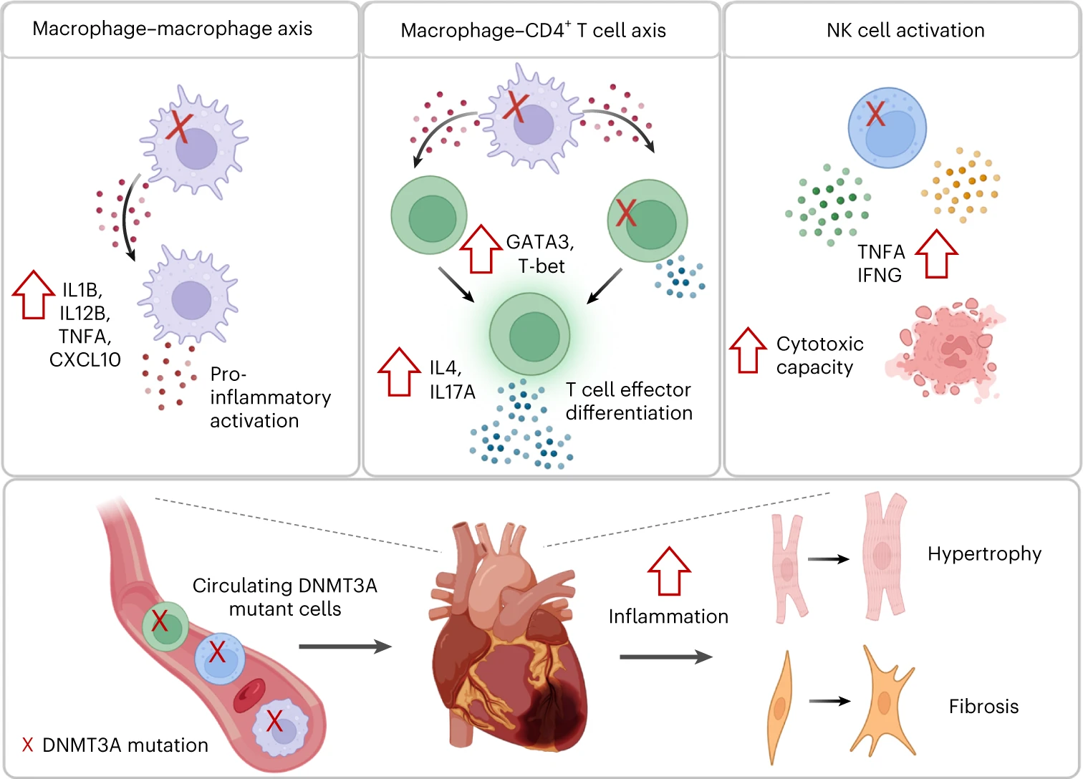
Cardiac-specific AAV variants for gene therapy
Innovation Cluster IC2
Pipeline: a cross-species vector engineering platform for novel heart-directed AAVs / interim example HDV-C1
Header
Header
XYZ Image description
XYZ Image description

Slide 6
Headline
Preclinical
Clinical
Prevention
Therapy
Medical devices
Genetics and
Gene therapy
Diagnostics
Epidemiology
Disease
Mechanisms
others

Slide 7



Future research programme infrastructure & core projects
cooperation
Partner:
Simone-F. Glaser
Michael Molitor
Vorarbeiten:
Abplanalp et al., Nucleic Acid Ther, 2020
Zweiter Zeile
Aim of study
Abplanalp et al., Nucleic Acid Ther, 2020
Zweiter Zeile
Impact /Mehrwert Herz-Kreislauf-Forschung & DZHK
Abplanalp et al., Nucleic Acid Ther, 2020
Zweiter Zeile

Slide 8


Copy & Paste Bibliothek
ABC
CC0000
5A84C4
FCB757
E63324
FFA050
E50050
D24150
C33B7C

